Slide 1
Communication in Distributed
Systems
Mercy Maina

Slide 2
Introduction
Communication defines the way processes on the same or different machines can exchange information
Communication in distributed systems is always based on low-level message passing as offered by the underlying network or through shared memory
It Involves Invoking
  Remote procedures;-
  Shared memory;-
  Socket. one endpoint of a two-way communication link between two programs running on the network
These methods allow nodes to exchange data and coordinate actions, enabling effective collaboration towards common goals

Slide 3
DS Communication Versus Inter-process Communication (IPC)
Distributed systems communication involves the interaction of independent, networked processes that do not share memory, primarily relying on message-passing to exchange data
Inter-Process Communication (IPC) represents a set of mechanisms provided by an operating system that allows multiple independent processes to share data and communicate with each other
Process refers to an independent instance of a running computer program.
Inter-process communication (IPC) in distributed systems enables independent processes on separate, networked computers to exchange data and synchronize actions, typically relying on message passing over protocols like sockets

Slide 4
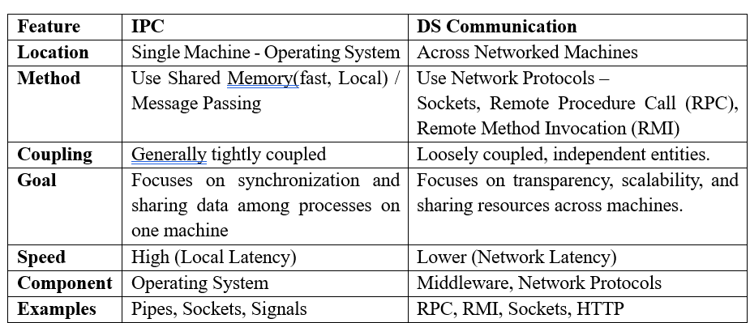
DS Communication Versus Inter-process Communication

Slide 5
Characteristics of IPC
Synchronous System Calls:
Asynchronous System Calls:
Message Destination:
Reliability:.
  Integrity:
  Validity:.
Ordering:

Slide 6
Methods in Inter-process Communication
Pipes (Same Process): virtual communication channel that allows data to be transferred between processes, either one-way or two-way.
Names Pipes (Different Processes):
Message Queuing: single or Multiple queues
Semaphores: Synchronization tool
Shared memory:
Sockets:

Slide 7
Categories Communication in Distributed Systems
Unstructured communication (use of shared memory or shared data structures)-
  It involves using memory buffers to pass information between the processes.
  A process reads and writes into a shared memory region in a machine to let other processes know of its local state so that the process can use that information. No explicit messages are used.
Structured communication - also called as ’message passing’, this uses explicit messages (or inter-process communication mechanisms) over network.

Slide 8
Communication Models and Types
Communication models in distributed systems refer to the patterns or paradigms used for enabling communication between different components or nodes within a distributed computing environment.
  Data Exchange, Coordination & Synchronization
Models
  Message Passing
  Remote Procedure Call (RPC)
  Publish-Subscribe Model / Broadcast
  Socket Programming Model / WebSockets/HTTP
  Shared Memory Model

Slide 9
Message Passing
One node sends a message to another node over a communication channel.
It is the primary mechanism for process communication in distributed systems,
Options
  Synchronous (blocking): Synchronous message passing involves a tightly coordinated interaction between the sender and receiver.
  Asynchronous (non-blocking): Asynchronous message passing allows processes to operate independently of each other in terms of timing
  Unicast Messaging: Unicast messaging is a one-to-one communication where a message is sent from a single sender to a specific receiver
  Multicast Messaging: Multicast messaging enables one-to-many communication, where a message is sent from one sender to a specific group of receivers
  Broadcast Messaging: Broadcast messaging involves sending a message from one sender to all nodes within the network

Slide 10
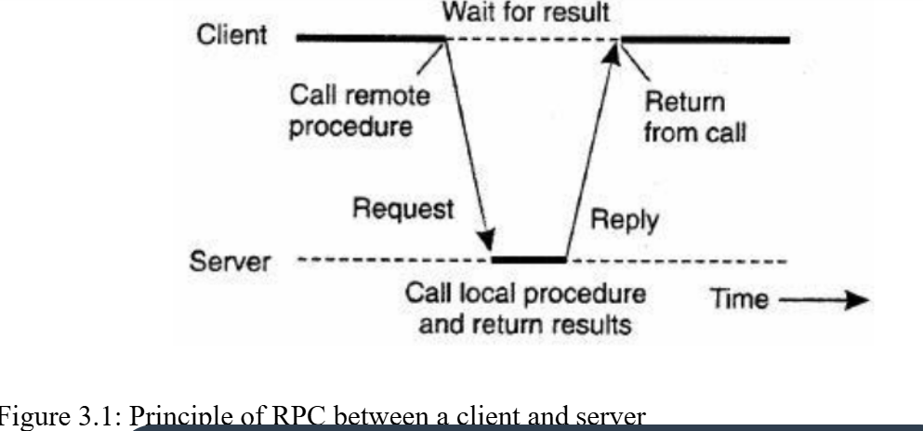
Remote Procedure Call (RPC)
Inter-process communication that allows a computer program to cause a procedure to execute in another address space if it were a local call,
Abstracts network details to simplify communication between networked services and nodes
Uses Parameters
No message passing is visible to the programmer

Slide 11
RPC Operation
Client Call: The client calls a local "stub" function, passing arguments. – Value, Reference, Copy/Restore
  Stubs - a piece of code used for converting parameters passed during a Remote Procedure Call - Client Stub & Server Stub
Marshalling: The client stub converts (marshals) the arguments into a network-transmittable format (e.g., JSON, binary).
Network Transfer: The message travels over the network (using TCP/UDP) to the server.
Server Stub: The server's stub receives the message, unmarshals the data, and calls the actual procedure on the server.
Execution: The server executes the remote function.
Return Value:

Slide 12
Transparency in RPC
Hiding the complexity of network communication, making a remote procedure call seem identical to a local one
Location Transparency: The client doesn't need to know the physical address of the server; it uses a logical name (like DNS) that gets resolved.
Language Transparency: Enables programs written in different languages to communicate by handling data representation differences (e.g., byte order).
Operating System Transparency: Allows programs on different operating systems (Windows, Linux) to call each other seamlessly.
Syntactic Transparency: The syntax of calling a remote procedure is identical to a local one (e.g., function(arg1, arg2) vs. remote_function(arg1, arg2)).
Semantic Transparency: The meaning and behavior of the remote call (suspension, argument passing, result return) are the same as a local call.

Slide 13
Publish-Subscribe Model / Broadcast:
An asynchronous messaging paradigm in distributed systems that decouples publishers of messages from subscribers via a broker, allowing multiple subscribers to receive messages published by one or more publishers
  Decoupling: Publishers do not know the identity or number of subscribers, fostering independent component operation
Suitable for dynamic and scalable distributed systems such as messaging systems,
  IoT platforms,.
  Real-time notifications: Broadcasting updates to online users.
  Event-driven architectures: Decoupling services that react to state changes.
  Live data streaming: Handling high-volume data feeds

Slide 14
Socket Programming Model / WebSockets/HTTP
Real-time or request-based communication, often over web services
Sockets act as endpoints for communication, defined by an IP address and a port number
Allows bidirectional communication between processes through sockets, supporting various protocols such as TCP/IP and UDP.

Slide 15
Shared Memory
Multiple processes or threads share a common address space (memory), allowing them to communicate by reading from and writing to shared memory locations
  common in Uniprocessor – Single processor
Distributed Shared Memory (DSM)
  Distributed Shared Memory (DSM) provides a virtualized, unified address space across multiple independent computers without shared physical memory

Slide 16
Communication Protocols in Distributed Systems
Defines the rules and conventions for exchanging data and coordinating actions between nodes or components within a networked environment.
Ensures reliable, efficient, and interoperable communication among distributed entities,
Protocols
  Transmission Control Protocol(TCP)
  User Datagram Protocol (UDP):
  Middleware Protocols:
  Hypertext Transfer Protocol (HTTP):
  Simple Mail Transfer Protocol (SMTP):
  File Transfer Protocol (FTP):
  Remote Procedure Call (RPC):
  Remote Method Innovation (RMI)

Slide 17
Communication Challenges
Unreliable Network: Messages can be dropped, delayed, or duplicated, requiring robust handling like acknowledgments, retries, and ensuring operations are idempotent.
Network Partitioning: Networks may split, isolating nodes from each other and leading to inconsistencies or "split-brain" scenarios.
High Latency and Jitter: Variability in message delays over wide-area networks can severely impact performance.
Lack of Global Clock: No shared, synchronized time makes ordering events across nodes difficult, with clock drift causing significant issues.
Security Risks: Communication, if not properly encrypted, is vulnerable to eavesdropping and interception.
Changing Topology: Nodes constantly join or leave, making it difficult to maintain a consistent view of the system.

Slide 18
Synchronization & Consistency Mechanisms in Distributed Systems Communication
Essential components of distributed systems, ensuring that multiple nodes or components can work together effectively and maintain data integrity across the system
Address the challenges posed by concurrent access, communication delays, and potential failures in distributed environments
Synchronization:
  Mutual Exclusion: Ensures that only one node or process accesses a shared resource at a time, preventing conflicts and data corruption
  Atomicity: Guarantees that operations on shared data either fully succeed or fail together as a single indivisible unit.
  Concurrency Control: Manages concurrent access to shared resources to prevent conflicts and maintain data consistency
  Barrier Synchronization: Coordinates the execution of multiple nodes by synchronizing them at predefined points in their execution

Slide 19
Consistency Mechanism ……./2
Consistency:
  Data Consistency: Ensures that all nodes in the distributed system have access to the same consistent view of data, regardless of their location or timing.
  Replication Consistency: Manages consistency among replicas of data stored across multiple nodes.
  Causal Consistency: Preserves the causal relationship between events in a distributed system, ensuring that events that are causally related are seen by all nodes in the same order.
  Eventual Consistency: Allows replicas of data to become consistent over time, even in the presence of network partitions or temporary inconsistencies

Slide 20
Performance and Scalability Considerations
Efficient communication ensures that nodes can collaborate effectively and achieve desired system goals while accommodating growth and increasing workload demands
To be considered;
  Message Passing Efficiency:
  Concurrency and Parallelism:
  Load Balancing:
  Caching and Data Locality:
  Horizontal and Vertical Scaling:

Slide 21
Middleware in Distributed System Communication
Definition
  Middleware is "software glue" that connects disparate applications, databases, and systems, enabling them to communicate, exchange data, and function as a unified system. It operates between the operating system and applications, facilitating tasks like authentication, data management, and messaging
  Middleware is infrastructure software that resides between the applications and the underlying operating systems, networks, and hardware, specifically intended to provide a more appropriate platform for building and operating distributed systems.
  Middleware is software that enables one or more kinds of communication or connectivity between applications or components in a distributed network, essentially creating "software glue" that binds different systems together.

Slide 22
Distributed Middleware
Definition
  Distributed middleware is a software layer situated between operating systems and applications that enables communication, data management, and coordination across heterogeneous, geographically dispersed systems.
  Distributed middleware is a software layer positioned between the operating system and applications, acting as "software glue" to manage complexity, heterogeneity, and communication across distributed systems
It enables, for instance, different operating systems and protocols to interact, allowing components on separate machines to operate as a single, coherent system
It abstracts network complexities, offering transparency in location and replication while ensuring scalability, fault tolerance, and interoperability

Slide 23
Middleware role
Communication Management
Transparency
Resource Management
Interoperability
Security
Scalability Support
Fault Tolerance and Recovery
Provide reusable services that can be composed, configured, and deployed to create distributed systems rapidly and robustly
Provides essential services such as naming, security, transactions, concurrency control, and data replication.

Slide 24
Main Types of Middleware
Message-oriented Middleware (MOM): Facilitates asynchronous, message-based communication, allowing systems to exchange data even if not active simultaneously.
Remote Procedure Call (RPC): Allows a program to call a function on another machine as if it were a local function.
Database Middleware: Facilitates access to heterogeneous databases.
Transaction Processing (TP) Monitors: Ensures reliability and atomic transactions across distributed components.
Distributed Object Middleware: Manages objects across networks (e.g., CORBA, Java RMI).
Enterprise Service Bus (ESB): Acts as a centralized hub for enterprise-level application integration

Slide 25
Middleware Challenges & Examples
Challenges
  Over-Engineering: Adding unnecessary features that increase complexity.
  Poor Scalability: Becoming a bottleneck if it cannot handle increased loads.
  Security Vulnerabilities: Inadequate protection, exposing the system to attack
  Scalability issues
  Consistency & Coordination
  Stability and Maintenance
  Transparent Requirements
Examples
  Message brokers (Apache Kafka, RabbitMQ),
  Application servers (Tomcat, JBoss)
  Transaction monitors.

Slide 26
Questions and Answers
End

